Slide 1

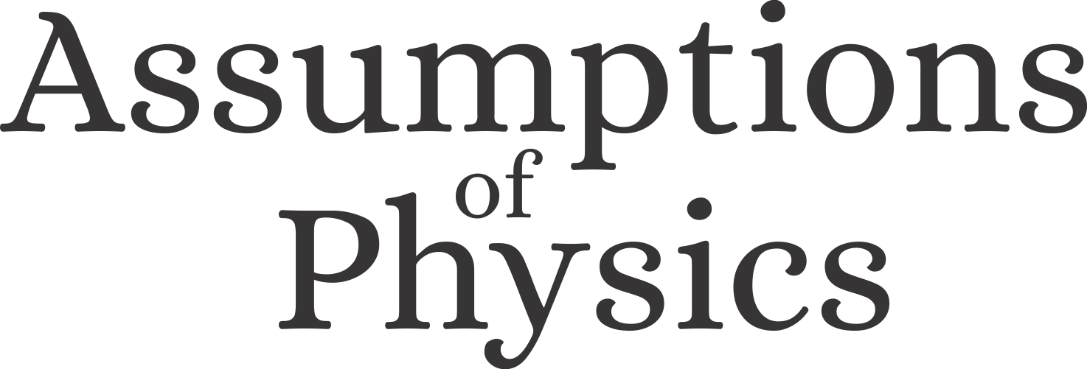
Time as an operational definition
Gabriele Carcassi
Physics Department
University of Michigan

Slide 2
Introduction
Together with Prof. Christine Aidala, I lead a project called Assumptions of Physics - https://assumptionsofphysics.org – that aims to find a minimal set of starting points from which the laws can be rederived
It consists of two main efforts:
Reverse physics – starts from the laws and finds physical assumptions that provide equivalent formulations
Physical mathematics – starts from physical ideas, carefully encodes them in formal definitions, rederives the familiar mathematical structures

Slide 3
The mathematical structure of time (i.e. real numbers with the standard topology) can be understood as coming from an idealized operational model of clocks
As time resolution increases, this model must fail and needs to be replaced with a more realistic account

Slide 4
Outline
What is time?
What it means to define something; the role of operational definitions in science; the topological structure imposed by experimental verification; the role of clock synchronization in defining time
A metrological model of time
The metrological and logical structure of clocks; the necessary and sufficient conditions for continuous time (i.e. real numbers).
Inevitable failure of time ordering
The untenability of the conditions for continuous time; how time ordering itself must break down.

Slide 5
What is time?

Slide 6
Hard question because time is elusive
What is time?
Then defining anything else should be easy!

Slide 7
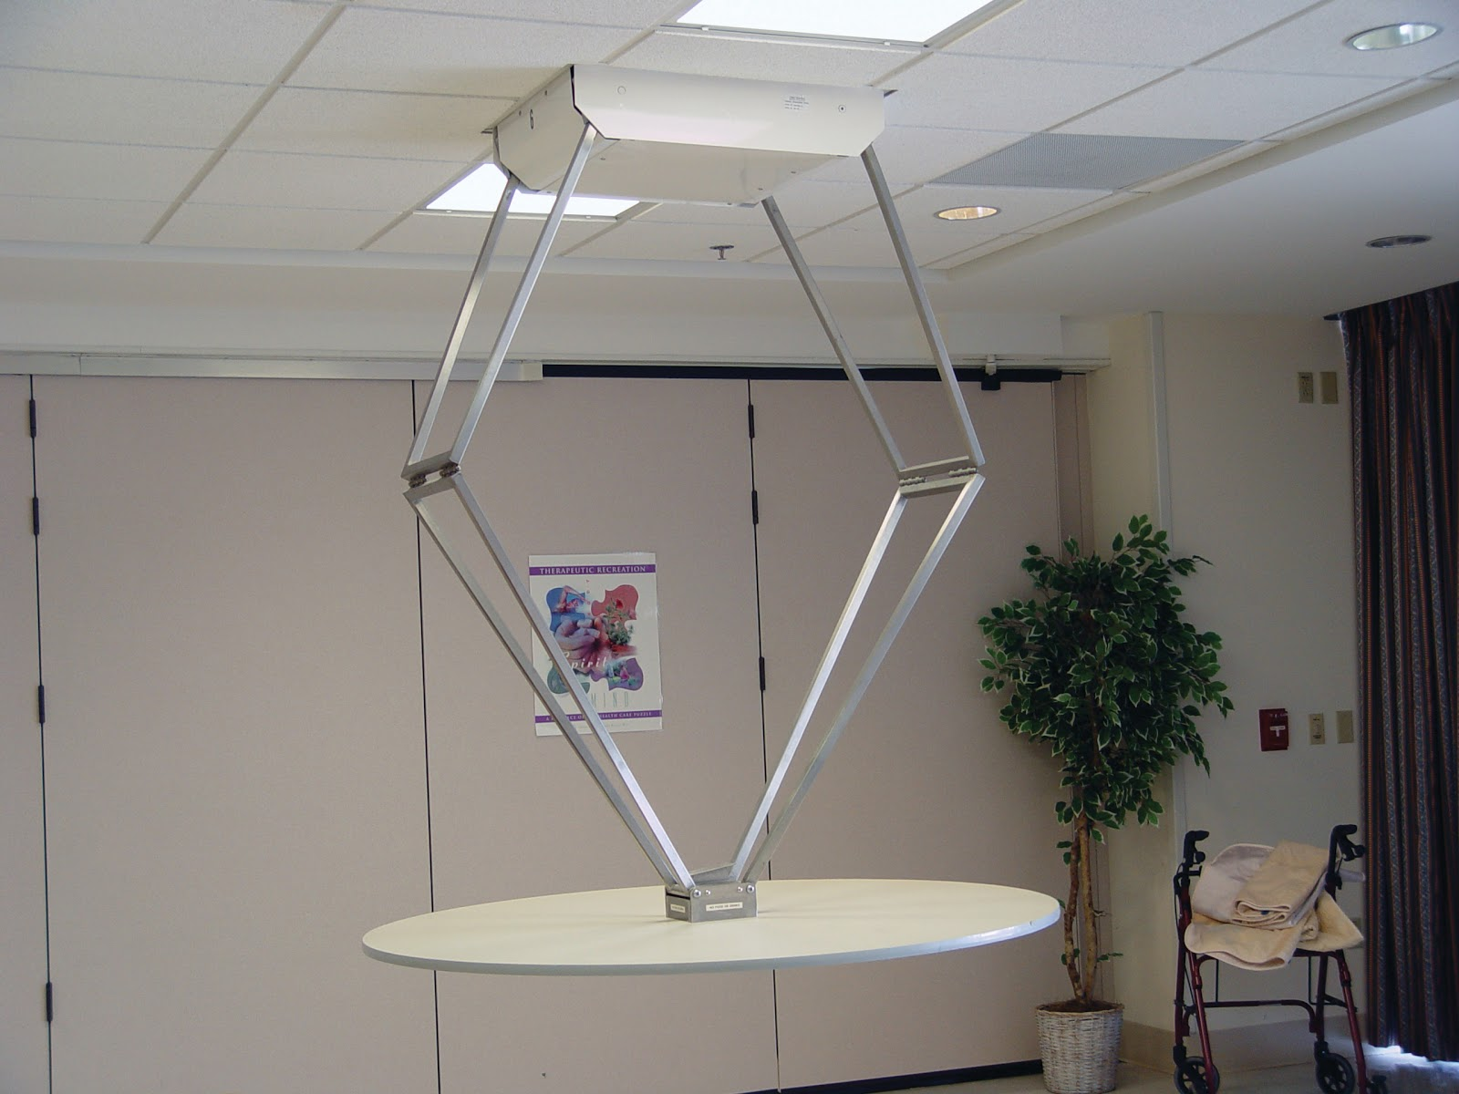
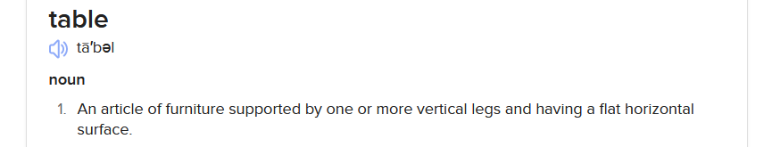
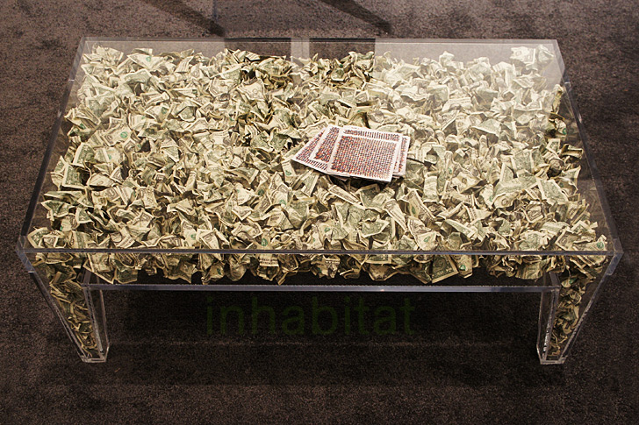


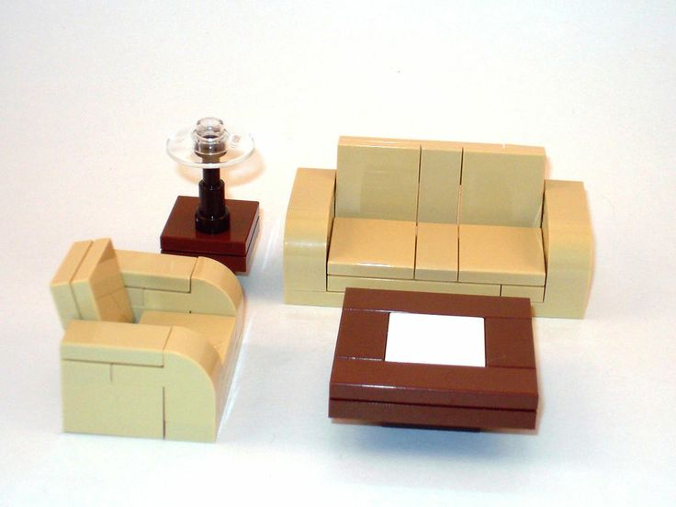
What is a table?

Slide 8
Hard question because “what is” is elusive
What is time?

Slide 9
Before giving a definition, we need to say:
What is the purpose of the definition?
What are the “primitive elements” that are allowed to be in the definition?

Slide 10
Because that’s what all well-defined math objects are!
In math, we want a formal definition: some set with some properties
E.g. a variable that can be used as a parameter for the evolution
I really don’t know: I still haven’t figured out what philosophers consider well-defined
In philosophy, we may look for an “ontological definition”: some intrinsic feature of reality
E.g. A nonspatial continuum in which events occur
These types of answers do not help us in a lab

Slide 11
In a lab, an operational definition is necessary and sufficient
operational: it tells me what to do
This is what physicists consider well-defined!
Time is what is measured by a clock
What is a clock?
A clock is what measures time
not operational: it does not tell me what to do

Slide 12

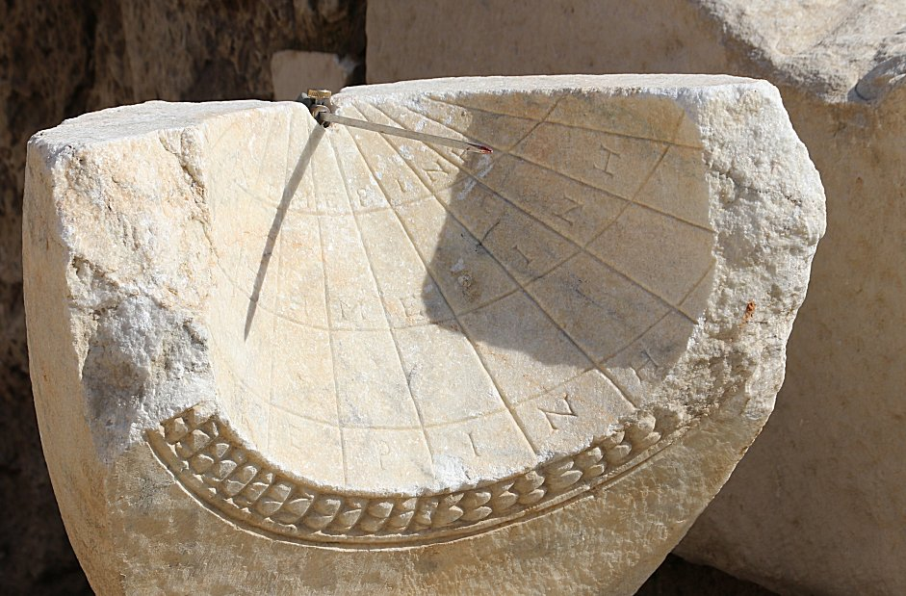

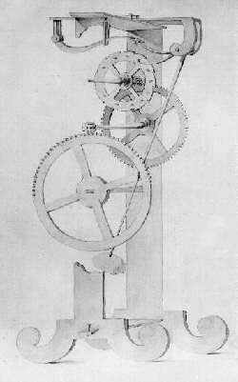
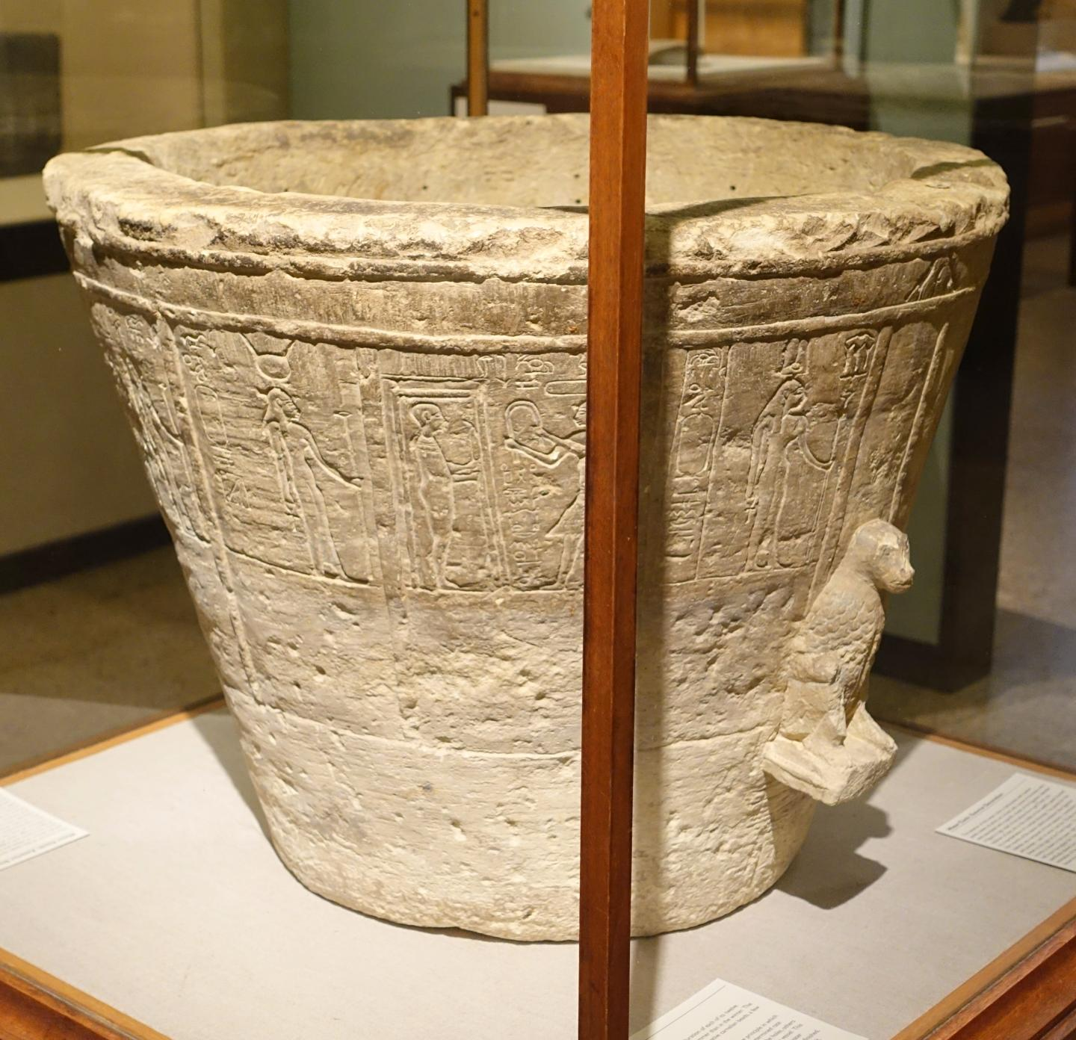
What is a clock?
The seasons
The sun
The heart (pulse)
A bucket of water with a hole
You can get a set of instructions on how to build these: they have operational definitions
But these are just examples of clocks!!!
A pendulum

Slide 13
What is a clock?
A clock is anything that can be synchronized to other clocks
Clock synchronization is operationally defined
The idea of time comes out of our ability to synchronize our clocks; examples serve to “jumpstart” the process

Slide 14

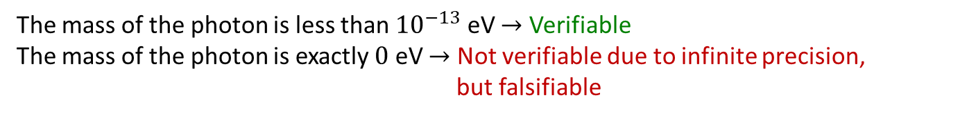
We solved the “purpose” question (i.e. operational definition)
We need to answer the “primitive elements” question
Verifiable statements: assertions that can be experimentally verified in a finite time
T | SUCCESS (in finite time)
F | UNDEFINED
 | FAILURE (in finite time)
The mass of the photon is less than ${10}^{−13}$ eV $→$ Verifiable
The mass of the photon is exactly $0$ eV $→$ Not verifiable due to infinite precision, but falsifiable
The syntax/semantics/structure of these statements cannot be formally specified further
For example, whether a specific statement is experimentally verifiable or even well-defined may depend on context (e.g. premises, idealization, theory, etc…)
The mass of the electron is 511 $±$ 0.5 KeV
When measuring the mass, it is a verifiable hypothesis
When performing particle identification, it is assumed to be true

Slide 15
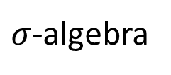
Experimentally distinguishable cases
Close under NOT and countable AND/OR (countably complete Boolean algebra),
statements formally associated with an experimental test
Theoretical statements
Precise map between physical concepts and their mathematical representation
Verifiable statements
Possibilities
Closed under finite AND and countable OR (Heyting algebra), generated by a countable set
$σ$-algebra
Borel sets
Points
All proofs can be “translated” into physically meaningful language
Open sets
Topology

Slide 16
A physical theory is fully specified by a countable set of verifiable statements and their logical relationships
All mathematical objects we use in physics (symplectic manifolds, tensors, Hilbert spaces, Lie groups, …) are ultimately identifying statements and their relationships

Slide 17
A metrological model of time

Slide 18
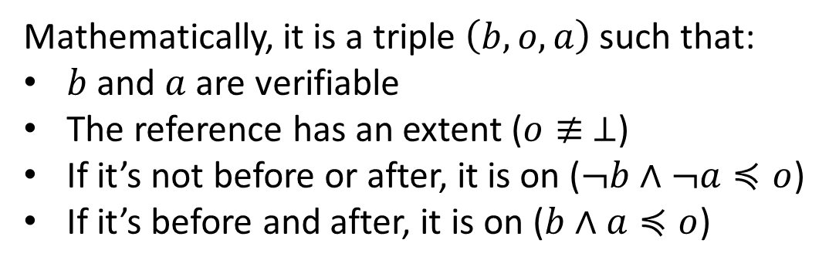
How do we formally model a clock?
A reference (i.e. a tick of a clock) is something that allows us to distinguish between a before and an after
Mathematically, it is a triple $\left(b,o,a\right)$ such that:
$b$ and $a$ are verifiable
The reference has an extent ($o≢ ⊥$)
If it’s not before or after, it is on ($¬b∧¬a≼o$)
If it’s before and after, it is on ($b∧a≼o$)
before
after
on
Before | On | After
T | F | F
F | T | F
F | F | T
T | T | F
F | T | T
T | T | T
A clock is a collection of references

Slide 19
Imagine collecting the references of all possible clocks into a single logical structure. What are the necessary and sufficient conditions such that they identify a point on the real line?
Intuitively, we would need clocks at higher and higher resolutions, all perfectly synchronized, …

Slide 20
1. Strict references
A reference is strict if before/on/after are mutually exclusive
before
after
Before | On | After
T | F | F
F | T | F
F | F | T
on
Physically, this means assuming that the extent of what we measure is smaller than the extent of our reference

Slide 21
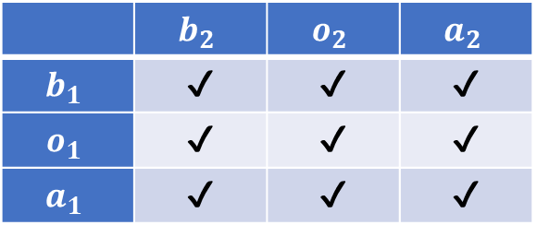
Multiple references
Without further constraints, references would not lead to a linear order
before
after
on
on
 | $$b_{2}$$ | $$o_{2}$$ | $$a_{2}$$
$$b_{1}$$ | ✔ | ✔ | ✔
$$o_{1}$$ | ✔ | ✔ | ✔
$$a_{1}$$ | ✔ | ✔ | ✔
before
after

Slide 22
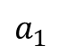
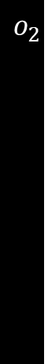
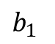
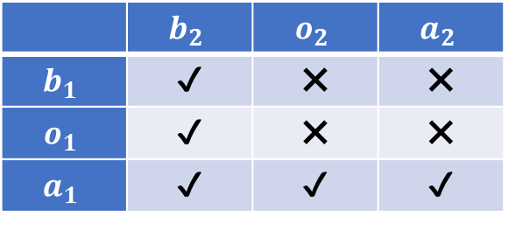
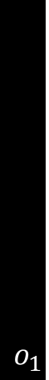
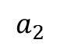
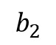
Multiple references
Note: the “boundaries” are ordered
The fact that a reference is “before” or “after” another is captured by the statements’ logical relationship
$$b_{2}$$
$$a_{2}$$
$$o_{1}$$
$$o_{2}$$
 | $$b_{2}$$ | $$o_{2}$$ | $$a_{2}$$
$$b_{1}$$ | ✔ | ✖ | ✖
$$o_{1}$$ | ✔ | ✖ | ✖
$$a_{1}$$ | ✔ | ✔ | ✔
$$b_{1}$$
$$a_{1}$$
But order relationship between references is too restrictive

Slide 23
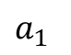

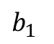

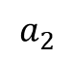
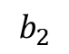
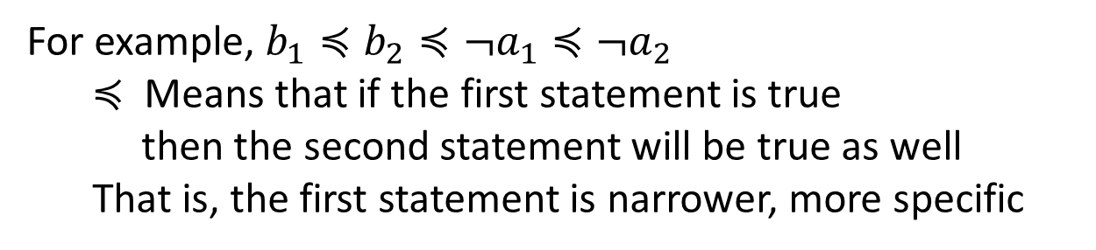
2. Aligned references
Two references are aligned if the before and not-after statement can be ordered by narrowness/implication
For example, $b_{1}≼b_{2}≼¬a_{1}≼{¬a}_{2}$
$≼$ Means that if the first statement is true then the second statement will be true as well
That is, the first statement is narrower, more specific
$$b_{2}$$
$$a_{2}$$
$$o_{2}$$
$$o_{1}$$
$$b_{1}$$
$$a_{1}$$

Slide 24
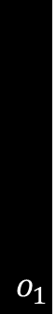
Filling the whole region
If two different references overlap, we can’t say one is before the other: we can’t fully resolve the linear order
$$o_{1}$$
$$b_{2}$$
$$o_{2}$$
$$a_{2}$$
$$a_{2}$$
$$b_{1}$$
$$a_{1}$$
$$b_{2}$$
$$o_{2}$$
$$o_{1}$$
Conversely, if two references don’t overlap and there can be something in between, we must be able to put a reference there
$$b_{1}$$
$$a_{1}$$

Slide 25
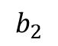



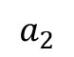
3. Refinable references
A set of references is refinable if we can address the previous two problems and resolve the full space
$$o_{3}$$
$$o_{1}$$
$$b_{2}$$
$$o_{2}$$
$$a_{2}$$
If two references overlap, we can find a references that refines the overlap
$$o_{3}$$
$$a_{2}$$
$$b_{1}$$
$$a_{1}$$
$$b_{2}$$
$$o_{2}$$
$$o_{1}$$
If something can be found between two references, then there must be another reference in between
$$b_{1}$$
$$a_{1}$$

Slide 27
Reference ordering theorem
To define an ordered sequence of “instants”, the references must be (nec/suff conditions):
Strict – an event is strictly before/on/after the reference (doesn’t extend over the tick)
Aligned – shared notion of before and after (logical relationship between statements)
Refinable – overlaps can always be resolved
Additionally:
Between any two references we can always have another reference $⇒$ real numbers
Only finitely many references between any two references $⇒$ integers
For time, these conditions are idealizations

Slide 28
Inevitable failure of time ordering

Slide 29
How does this model of time break down?
The ticks of a clock have an extent and so do the events (references not strict)
If clocks have jitter, they cannot achieve perfect synchronization (references not aligned)
We cannot make clock ticks as narrow as we want (references not refinable)
No consistent ordering: no “objective” “before” and “after”
In relativity, different observers measure time differently, but the order is the same. We should expect this to fail at “small” scales.
A better understanding of space-time means creating a more realistic formal model that accounts for those failures

Slide 30
What type of models should we use?
Hard to say, but we can argue from necessity
(N.B. this is a toy model, each point should have infinitely many neighbors)
Lack of order at small scales, order at large enough scale
What we can distinguish experimentally (i.e. topology) seems to be linked to how precisely we want to distinguish (i.e. geometry)
Current mathematical tools have a hard division between topology and geometry
Likely need new math

Slide 31
Our reasoning contradicts the expectations of many that time is simply “discrete” at the smallest scale
This intuition is based on the idea that the continuum is like the discrete but “with more points”
This idea (though extremely common in physics) is flawed

Slide 32
Topology of the reals
Connected: cannot be divided into two disjoint open sets
Open set – open interval
Always space between two references that do not overlap: it’s what makes it a continuum
No contingent decidable statements
Reference
Topology of the integers
Disconnected: can be divided into two disjoint open sets
No space between two consecutive references
Reference
All contingent statements are decidable

Slide 33
Conclusion
Physically well-defined objects must be in terms of operational definitions
The primitive elements are the verifiable statements, which are typically idealized and left formally undefined
A physical theory is fully characterized by the logical relationships of countably many verifiable statements
Time is what is measured by a clock
The main feature of clocks is that they can be synchronized with each other, which is operationally defined
Clocks can be formally modeled by a set of ticks that experimentally define a before and after
We recover time as a continuum under suitable idealized conditions (i.e. all clocks can be perfectly synchronized, reach arbitrary resolution, … )
We should not expect the assumptions required by ordered (and continuous) time to hold at the smallest scale
A better understanding of space-time means creating a more realistic formal model that takes into account those failures

Slide 35
Supplemental

